Slide 1

New York Yellow Taxi Trips in January 2021
Judley Joseph
February 2022

Slide 2

Business Objective(s)
The primary goals for our taxi business is to make sure our driver’s time on the road is as productive as possible.
Our second primary goal is to retain customers so they have a positive experience and repeatedly use our service
Engagement and retention metrics will be the best way to evaluate the performance of our taxis.

Slide 3
Metrics That Matter
Engagement
Trip Duration
Customer Satisfaction
Total Tips
Retention
Retention Rate
Churn Rate
Daily Active Users
Missing Data: Unique User ID, Satisfaction Score

Slide 4
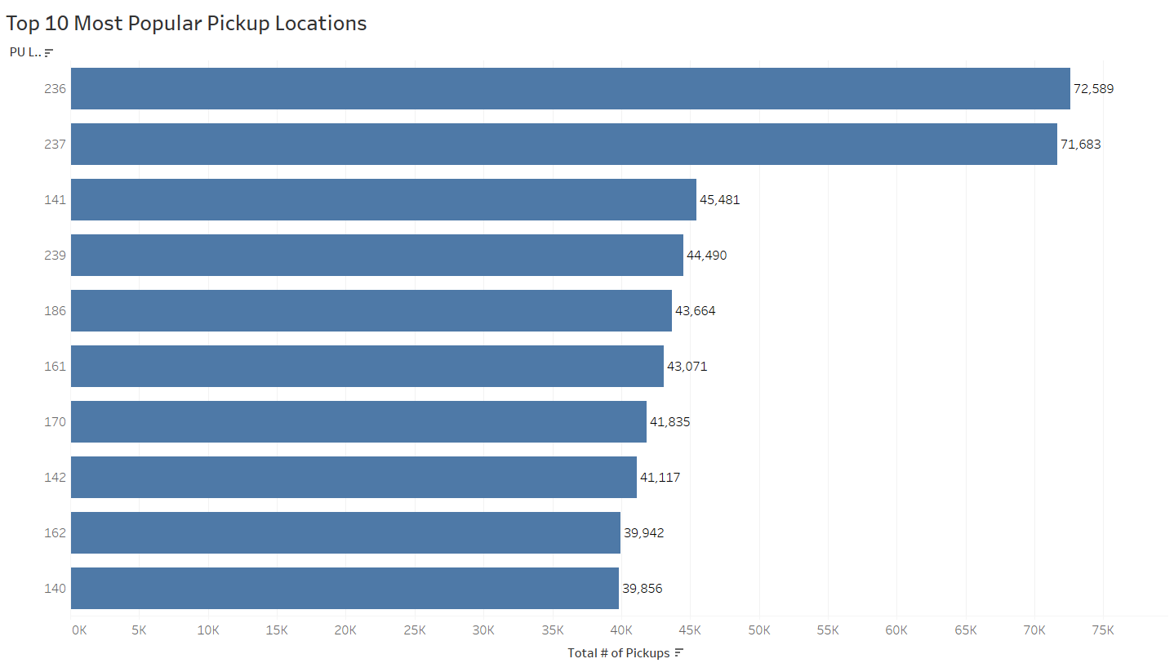
The top 10 most popular pickup locations out of 264 total locations make up ~38% of all rides.

Slide 5
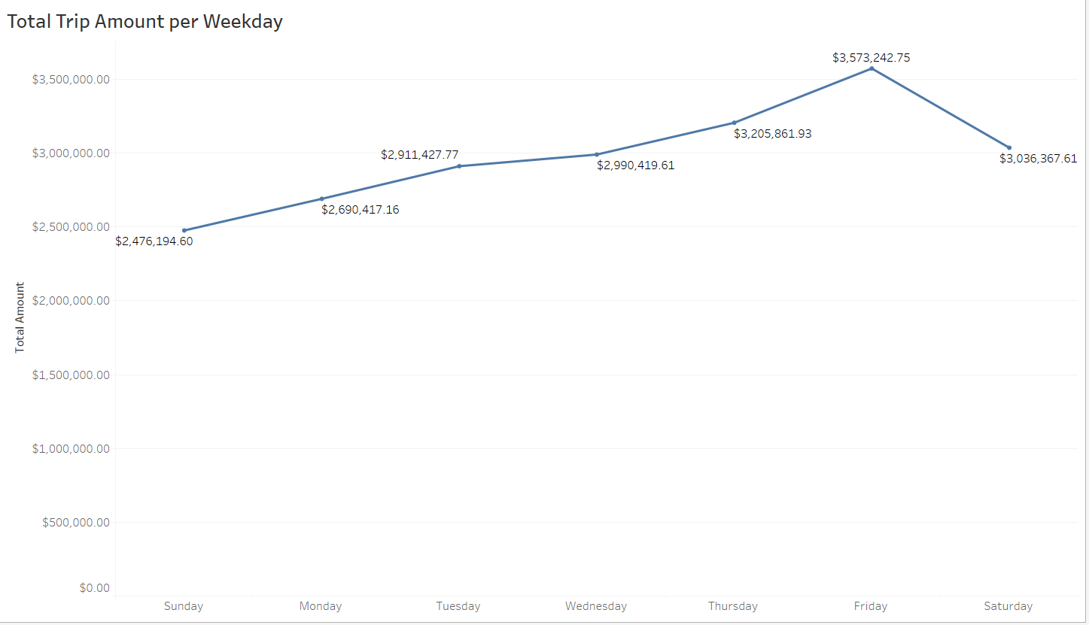
In terms of Total Amount Earned, Sundays are the lowest earning days with Fridays being the highest

Slide 6
Analysis/Insight
Based on our first graph, in order to maximize the use our taxi, we should focus our efforts into the top 10 pickup locations. Doing this will assist with acquiring new customers and retaining them as well.
In order to properly calculate retention rate, we need to be able to collect a unique user id for each consumer. This way we can also obtain daily active users. Our current data is not enough to compute these metrics

Slide 7
Recommendations
GOAL | CURRENT STATE | PROPOSAL | VALIDATION
Acquire new customers, retain existing ones, and keep customers engaged | Our taxis are being spread over 200 + pickup locations, time spent on road is not maximized | Remove taxis from unpopular areas and place them in locations with more consumers | Multivariate testing on different locations

